Slide 1
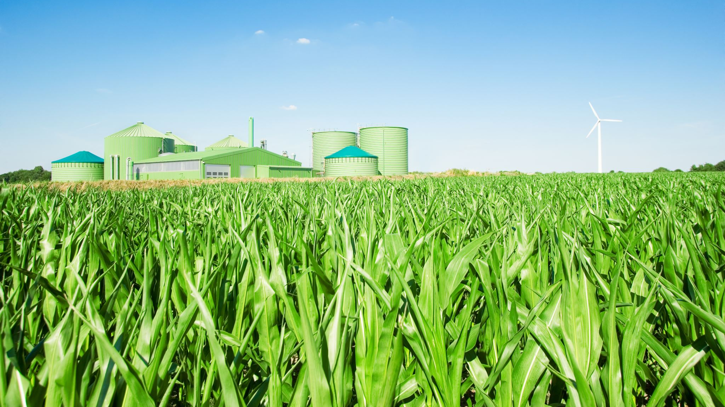
Unnamed project (Core29)
Stuart Keith, Matthew Holmes, Alistair McCulloch

Slide 2
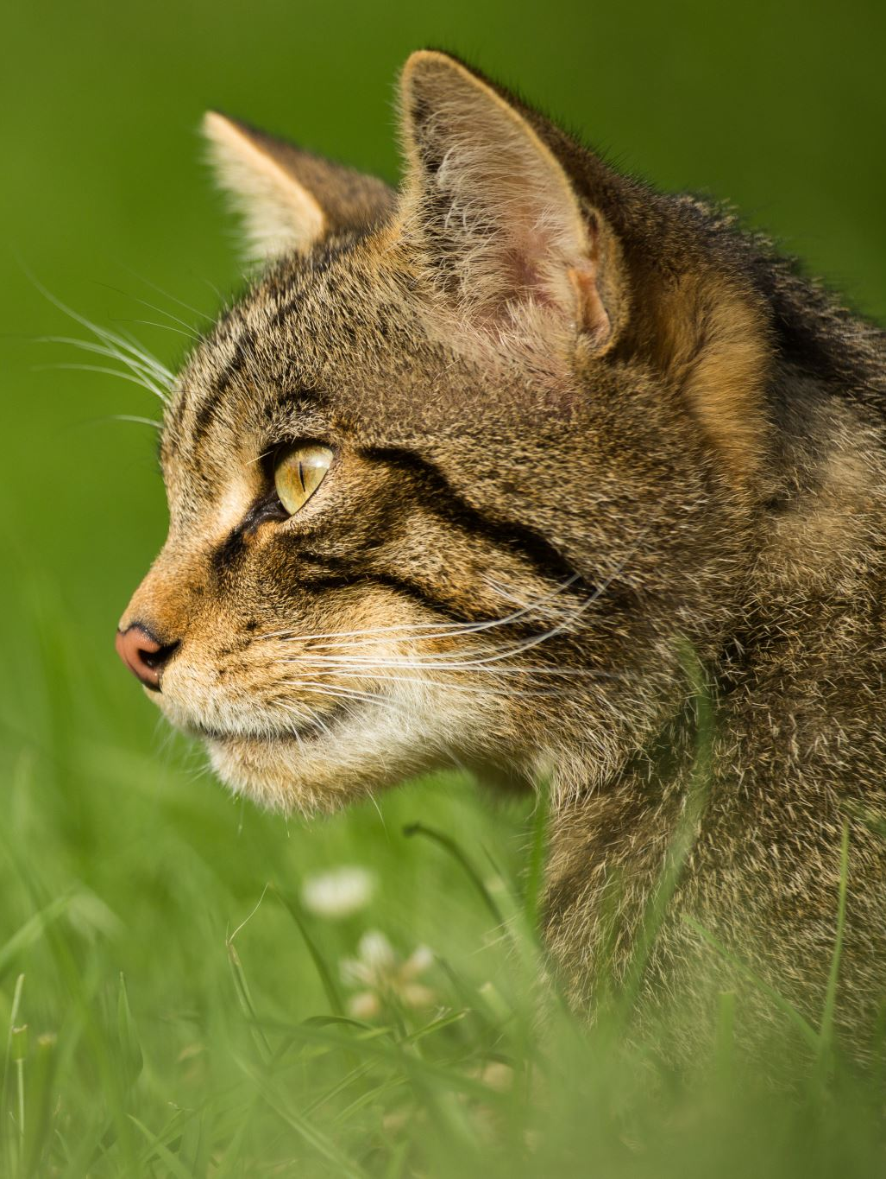
Our Task
Our challenge presented to us by Core29 was to develop an intelligent wildlife tracking application.
This application’s purpose is to allow users to submit, categorise, and analyse wildlife data. This will focus on streamlining data collection, enhance categorisation accuracy, and provide insights through visualisations or predictive analysis.

Slide 3
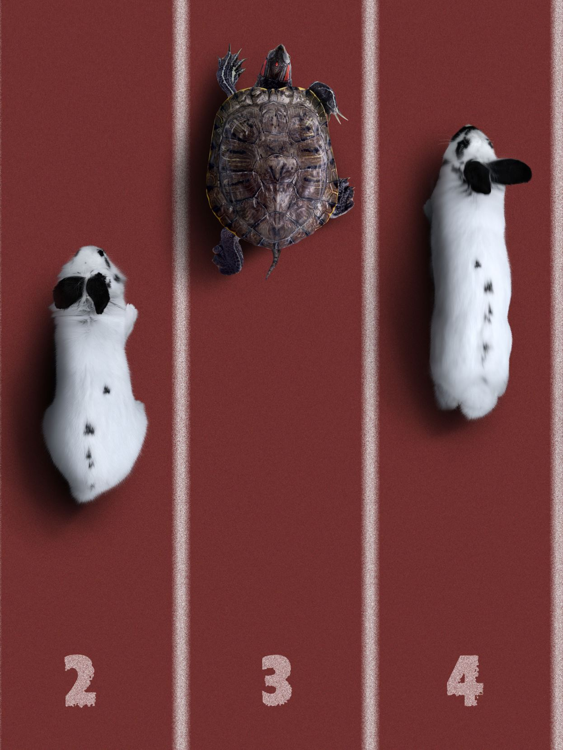
Our Solution
We as a team have developed a web-based application featuring the following:
A login/signup page
A page for users to add and filter through data to a list
A photo scanner to recognise an animal using an image uploaded by the user

Slide 4
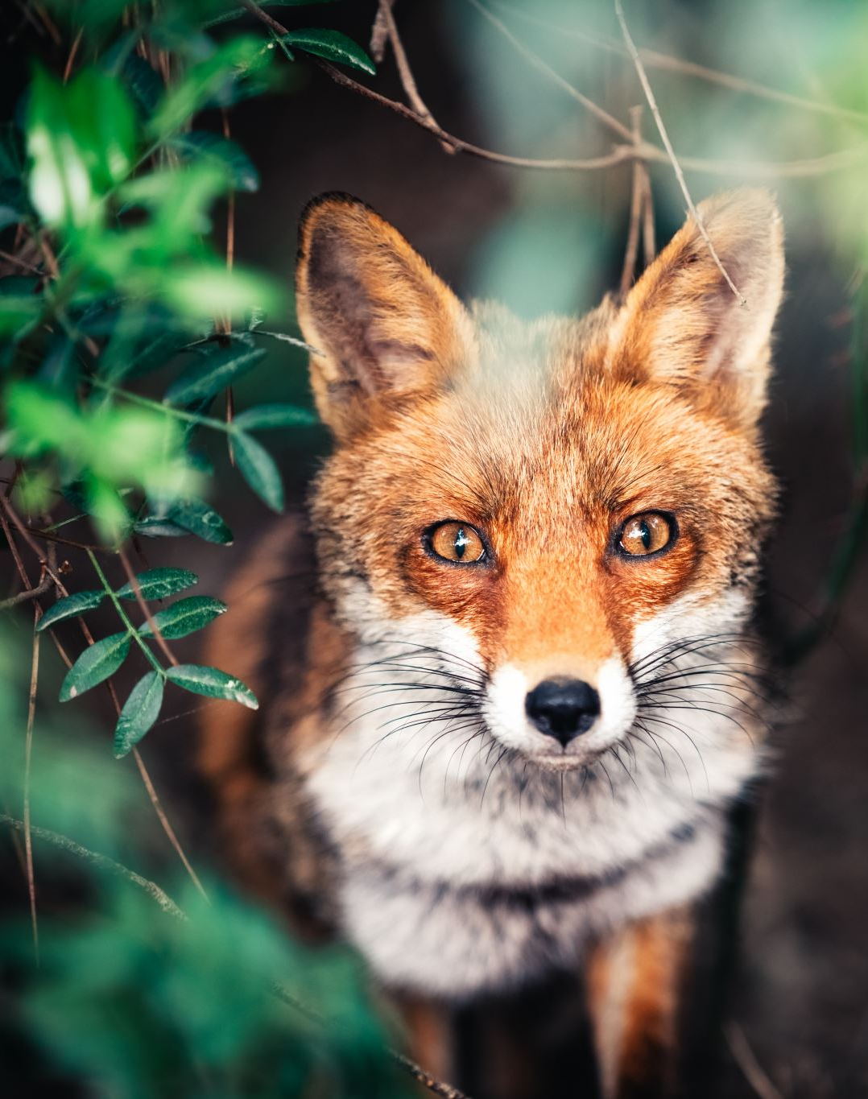
Practical Demonstration
We will now give a practical demonstration of our project to showcase some of the amazing features we have included.

Slide 5
And with your help, together we can save the wildlife!

Slide 6
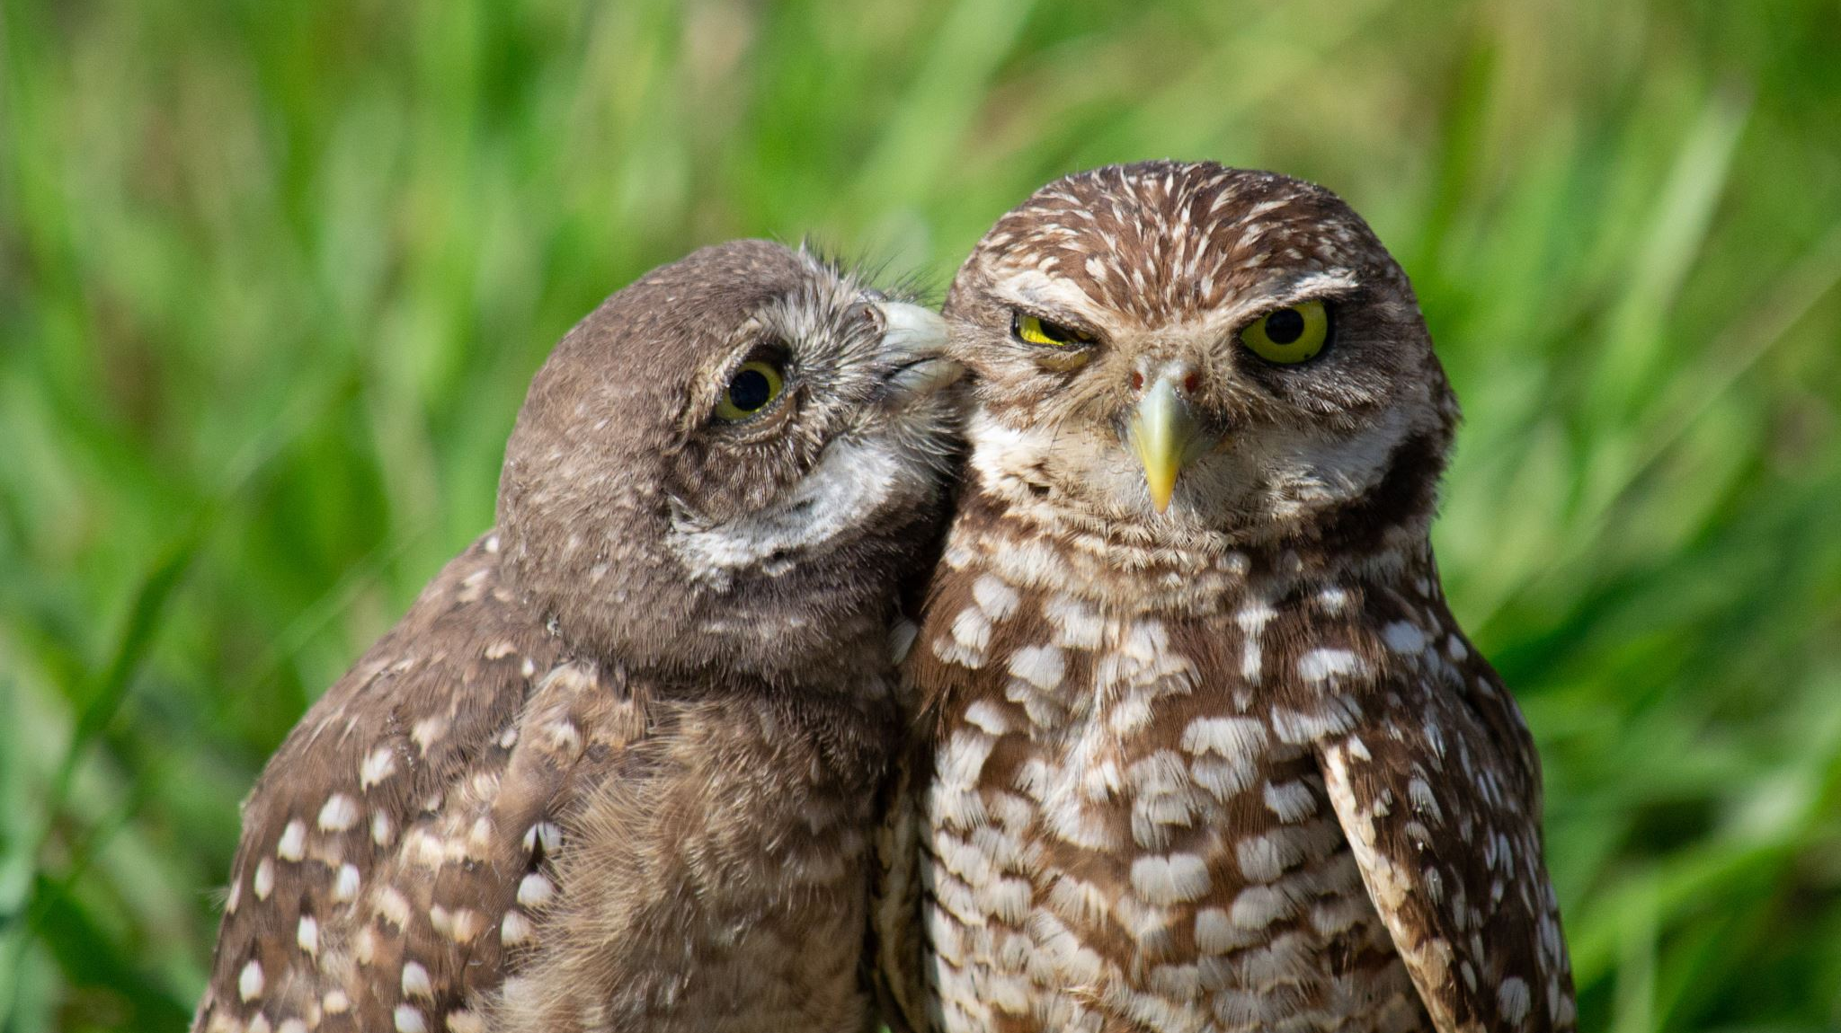
And with your help, together we can save the wildlife!

